Slide 1
Effect of short left-turn bay on intersection capacity
Yukai Huang

Slide 2
Outline
Introduction
Objective
Literature review
Numerical Example
Deficiencies of the current studies
Further analysis

Slide 3
Introduction
At intersections with high left-turn demand in conjunction with high opposing through flow, a protected left-turn signal phase, which can be provided before (leading) or after (lagging) the through movement, is generally used.
During the peak hour when there is a high demand of through and left-turn traffic, the length of the left-turn bay may affect the left-turn capacity and sometimes even the adjacent through capacity due to the occurrence of spillback and blockage situation.
Blockage: during the green phase of left-turn traffic, the left-turn bay is blocked by the queue of through traffic.
Spillback: during the green phase of the through traffic, the adjacent lane next to the left-turn bay is blocked by the queue of left-turn traffic.

Slide 4
Objective
Objective:
Analyze how the short left-turn bay will affect the intersection capacity under the condition that the left-turn is protected and leading.
Input:
Arrival rate
Geometric information (Number of lanes…)
Length of left-turn bay
Signal information (Cycle length…)

Slide 5
Literature review
Simulation based
Year
Analytical model based
Related topic
Determent the length of left-turn bay
Messer and Fambro (1977) TRB
Zong Z. Tian and Ning Wu (2006) JTE
Right-turn -> left-turn
Qi and Yu et al. (2007) TRB
Kikuchi et al. (2007) TRB
. . .
Zhang and Tong (2008) TRB
Residual queue
Signal timing
Reynolds and Zhou (2010) TRB
Yin, Zhang and Wang (2010) TRB
Osei-Asamoah et al. (2010) TRB
HCM (2010)
Phase sequence
Delay
Reynolds and Zhou (2011) TRB
Yin, Zhang and Wang (2011) TRB
Haddad and Geroliminis (2012) STRC
Next

Slide 6
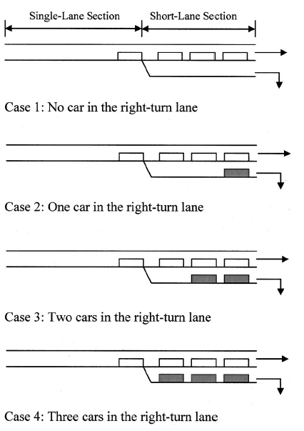
Literature review
Zong Z. Tian and Ning Wu. Probabilistic Model for Signalized Intersection Capacity with a Short Right-Turn Lane, Journal of Transportation Engineering. 2006.
Pt –> through vehicle
(1-pt) --> right turn vehicle
Pr(x=Vtotal) ~ Poisson Distribution
Pr(x=VRT) ~ $\left({V_{total} \atop V_{RT}}\right){(1−p_{t})}^{V_{RT}}{p_{t}}^{(V_{total}−V_{RT})}$
Back

Slide 7
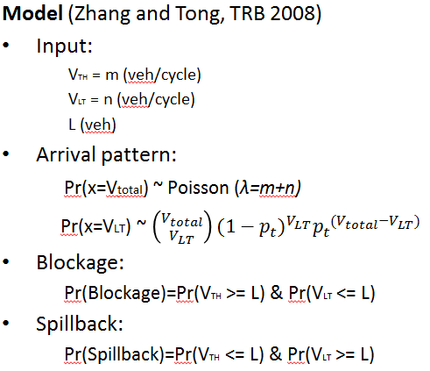
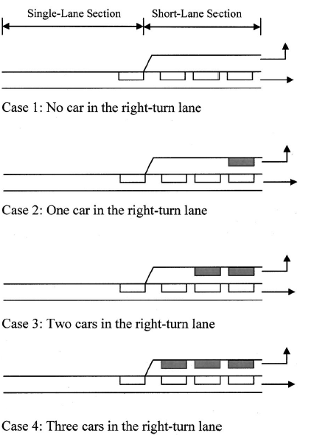
Literature review
Zhang and Tong. Modeling Left-Turn Blockage and Capacity at Signalized Intersection with Short Left-Turn Bay, TRB, 2008.
Back

Slide 8
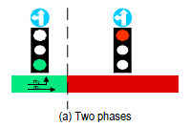
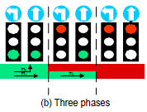
Literature review
Analytical model-based
Kai Yin, Yunlong Zhang, and Bruce X. Wang. Analytical Models for Protected plus Permitted Left-Turn Capacity at Signalized Intersection with Heavy Traffic, TRB, 2010.
This paper adjusted Zhang and Tong’s paper (2008) by consider the residual queue of the through traffic under heavy traffic situation.
Kai Yin, Yunlong Zhang, and Bruce X. Wang. Modeling Delay During Heavy Traffic for Signalized Intersections with Short Left-Turn Bays, TRB, 2011.
This paper used the same approach to further analyze the delay by considering blockage and spillback situations.
Abigail Osei-Asamoah, Ashish Kulshrestha, et al. Impact of Left-Turn Spillover on Through Movement Discharge at Signalized Intersections, TRB, 2010.
This paper stated that Zhang and Tong’s paper (2008) is the only study identified that explicitly examined the impact of left-turn lane spillover on through movement discharge.
This paper adjusted the probability of spillback situation by considering the arrival vehicles during red interval.
Jack Haddad, Nikolas Geroliminis. Capacity of arterials with left-turn queue spillbacks, STRC, 2012.
This paper considered two different signal phase sequences.
Back

Slide 9
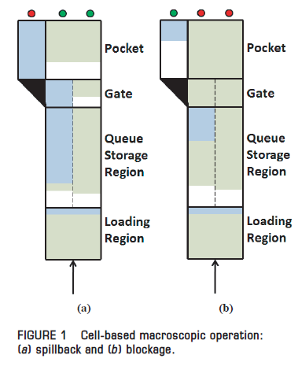
Literature review
Simulation-based
William L. Reynolds, Xuesong Zhou, et al. Estimating Sustained Service Rates at Signalized Intersections with Short Left-Turn Pockets, TRB, 2010.
William L. Reynolds et al. Turn Pocket Blockage and Spillback Models, TRB, 2011
Using cell transmission model with the assumption that the arrival pattern is uniformed.
Simulation-based method can consider more details and the result may be closer to reality, however it’s hard to be applied in general and it needs lots of energy and time.
Back

Slide 10
Literature review
Determent the length of left-turn bay
Yi Qi, Lei Yu, Mehdi Azimi, and Lei Guo. Determination of storage lengths of left turn lanes at signalized intersections. TRB, 2007.
Estimate the queue length under 95% confident interval based on arrival pattern, and make the length of left-turn bay larger than it to avoid blockage situation.
Shinya Kikuchi, Nopadon Kronprasert, and Masanobu Kii. Lengths of Turn Lanes on Intersection Approaches. TRB, 2007.
Define some acceptable conditions (threshold probability) and calculate the suitable bay length that satisfies the thresholds.
Back

Slide 11
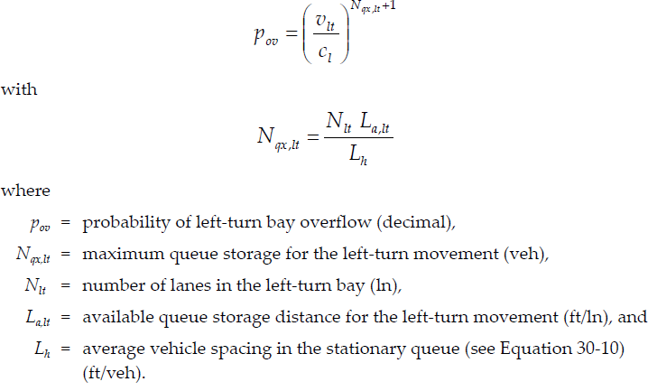
Literature review
HCM 2010
Capacity of unsignalized intersections with left-turn bays

Slide 12
Literature review
HCM 2010
Capacity of signalized intersections with left-turn bays
No recommended model, only some simulation results under some assumed scenarios.
For case‐specific applications, parameters that could influence the evaluation of bay overflow include the following:
Number of lanes for each movement,
Demand volumes for each movement,
Impedance of left‐turning vehicles by oncoming traffic during permitted periods,
Signal timing plan (cycle length and phase times),
Factors that affect the number of left‐turn sneakers for left‐turn movements that have permitted operation, and
Other factors that influence the saturation flow rates.
Back

Slide 13
Numerical Example (Method from Zhang and Tong 2008)
Input:
-Left-turn traffic arrival rate: λ_{LT}=400veh/h;
-Through traffic arrival rate: λ_{TH}=800veh/h;
-Number of through lanes: nl=2;
-Length of left-turn bay: N=6veh;
-Cycle length: C=90s;
-Through traffic green time: g_{TH}=27s;
-Left-turn traffic green time: g_{LT}=27s;
-Saturation flow rate: s=2000veh/h;
-Phase sequence: left-turn leading.

Slide 14
Numerical Example (Method from Zhang and Tong 2008)
Step 1: Calculate the blockage probability:
When number of arriving vehicle per cycle is less than 2N:
$PBlockage(V<2N)= \sum_{V=N}^{V=2N−1}{\sum_{vLT=0}^{vLT=V−N}{P\left(x=V\right)∗\left({V \atop vLT}\right)}}{pt}^{(V−vLT)}{(1−pt)}^{vLT}$
Where,
V is the total arriving vehicle number;
v_{LT} is the number of left-turn vehicles that can enter the left-turn bay before blockage;
P(x=V) is the probability that arriving vehicle number equals to V under Poisson distribution
with λ=λ_{LT}+λ_{TH} , which can be calculated as: $P\left(x=V\right)=\frac{λ^{V}∗e^{−λ}}{V!}$;
p_{t} is the percentage of through traffic, which equals to p_{t} = λ_{TH}/(λ_{LT}+λ_{TH});
When number of arriving vehicle per cycle is less than 2N:
$PBlockage(V≥2N)= \sum_{V=2N}^{V=VMax}{\sum_{vLT=0}^{vLT=N−1}{P\left(x=V\right)∗\left({V \atop vLT}\right)}}{pt}^{(V−vLT)}{(1−pt)}^{vLT}$
Where,
V_{Max} is the maximum number of vehicle that possibly can arrival in one cycle;

Slide 15
Numerical Example
Step 1: Calculate the blockage probability:
Calculate the total probability of blockage:
$$PBlockage=PBlockage\left(V<2N\right)+PBlockage(V≥2N)$$
In this case, P_{Blockage}=49.7%.

Slide 16
Numerical Example
Step 2: Calculate the expected number of left-turn vehicles that can can arrive before blockage situation :
When number of arriving vehicle per cycle is less than 2N:
$EvLT(V<2N)= \sum_{V=N}^{V=2N−1}{\sum_{vLT=0}^{vLT=V−N}{vLT∗P\left(x=V\right)∗\left({V \atop vLT}\right)}}{pt}^{(V−vLT)}{(1−pt)}^{vLT}$
Where,
V is the total arriving vehicle number;
v_{LT} is the number of left-turn vehicles that can arrive before blockage situation;
P(x=V) is the probability that arriving vehicle number equals to V under Poisson distribution
with λ=λ_{LT}+λ_{TH} , which can be calculated as: $P\left(x=V\right)=\frac{λ^{V}∗e^{−λ}}{V!}$;
p_{t} is the percentage of through traffic, which equals to p_{t} = λ_{TH}/(λ_{LT}+λ_{TH});
When number of arriving vehicle per cycle is less than 2N:
$EvLT(V≥2N)= \sum_{V=2N}^{V=VMax}{\sum_{vLT=0}^{vLT=N−1}{vLT∗P\left(x=V\right)∗\left({V \atop vLT}\right)}}{pt}^{(V−vLT)}{(1−pt)}^{vLT}$
Where,
V_{Max} is the maximum number of vehicle that possibly can arrival in one cycle;

Slide 17
Numerical Example
Step 2: Calculate the expected number of left-turn vehicles that can arrive before blockage situation:
Calculate the total expected number:
$$E(vLT)=EvLT\left(V<2N\right)+EvLT(V≥2N)$$
In this case, E(v_{LT})=2.06.
Step 3: Calculate the left-turn capacity under the given condition:
Left-turn capacity:
$$CLT=E\left(vLT\right)+\left(1−PBlockage\right)∗\frac{s∗gLT}{C}$$
In this case, C_{LT}=9.59 (veh/cycle) or 1280 (veh/h)

Slide 18
Numerical Example
Step 4: Calculate the spillback probability:
When number of arriving vehicle per cycle is less than 2N:
$PSpillback (V≤2N)= \sum_{V=N+1}^{V=2N}{\sum_{vTH=0}^{vTH=V−N−1}{P\left(x=V\right)∗\left({V \atop vTH}\right)}}{pt}^{vTH}{(1−pt)}^{(V−vTH)}$
Where,
V is the total arriving vehicle number;
v_{TH} is the number of left-turn vehicles that pass adjacent through lane before spillback;
P(x=V) is the probability that arriving vehicle number equals to V under Poisson distribution
with λ=λ_{LT}+λ_{TH} , which can be calculated as: $P\left(x=V\right)=\frac{λ^{V}∗e^{−λ}}{V!}$;
p_{t} is the percentage of through traffic, which equals to p_{t} = λ_{TH}/(λ_{LT}+λ_{TH});
When number of arriving vehicle per cycle is less than 2N:
$PSpillback(V>2N)= \sum_{V=2N+1}^{V=VMax}{\sum_{vTH=0}^{vTH=N−1}{P\left(x=V\right)∗\left({V \atop vLT}\right)}}{pt}^{vTH}{(1−pt)}^{(V−vTH)}$
Where,
V_{Max} is the maximum number of vehicle that possibly can arrival in one cycle;

Slide 19
Numerical Example
Step 4: Calculate the blockage probability:
Calculate the total probability of blockage:
$$PSpillback=PSpillback\left(V≤2N\right)+PSpillback(V>2N)$$
In this case, P_{Blockage}=27.5%.
Step 5: Calculate the expected number of through vehicles that can arrive before spillback in each cycle:
Using the same method as step 3,
$$E(vTH)=EvLH\left(V≤2N\right)+EvLH(V>2N)$$
So in this case, E(v_{TH})=0.95.
Step 6: Calculate the through capacity under the given condition:
Through capacity:
$$CTH=(E\left(vTH\right)+PSpillback∗\frac{s∗\left(nl−1\right)∗gTH}{C})+\left(1−PSpillback\right)∗\frac{s∗nl∗gTH}{C}$$
In this case, C_{TH}=26.83 (veh/cycle) or 3577 (veh/h)
So in summary, C_{LT}=1280(veh/h), C_{TH}=3577(veh/h).

Slide 20
Deficiencies of the current studies
Process of a cycle:
Blockage
Blockage
Spillback
A
B
C
D(A’)
LT:
TH:

Slide 21
Deficiencies of the current studies
Deficiency 1:
The model has not considered that red phase for left-turn traffic starts earlier than the red phase for through traffic.
Pr(Blockage)=Pr(XTH>=N+2)*Pr(XLT<=N+2)
The initial queue for the left-turn traffic has been ignored.
Pr(Blockage)=Pr(XTH>=N+2)*Pr(XLT<=N+2-qLT)

Slide 22
Deficiencies of the current studies
Process of a cycle:
Blockage
Blockage
Spillback?
Spillback
A
B
C
D(A’)
LT:
TH:

Slide 23
Deficiencies of the current studies
Video:

Slide 24
Deficiencies of the current studies
Deficiency 2:
The current model cannot well reflect the real spillback cases.
Pr(Spillback)=Pr(XTH<=N+2)*Pr(XLT>=N+2)
The probability of spillback situation may be overestimated.

Slide 25
Deficiencies of the current studies
Process of a cycle:
Blockage
Blockage
Spillback?
Spillback
A
B
C
D(A’)
LT:
TH:

Slide 26
Further analysis
Idea
Point A:
Existing queue (qLT)
Point A → Point C:
Probability of blockage (Prblock)
Expected # of LT vehicles that pass the intersection (Vcapacity)
Expected # of LT vehicles that do not pass (Vnopass)
Point C → Point A’:
Probability of spillback under all different cases (Prspill)
New expected existing queue for next cycle (qLT’)
A
B
C
D(A’)
LT:
TH:

Slide 27
Further analysis
Input:
Left-turn traffic arrival rate: a_{LT} (veh/h);
Total through traffic arrival rate: a_{TH} (veh/h);
Cycle length: C (s);
Green time for through traffic: g_{TH} (s);
Green time for left-turn traffic: g_{LT} (s);
Bay length: L (veh);
Saturation flow rate: s (veh/h);
Initial existing left-turn queue at A: $q_{LT}^{A}$
A
B
C
D(A’)
LT:
TH:

Slide 28
Further analysis
Notation:
i is the number of through vehicles arriving during AC;
j is the number of left-turn vehicles arriving during AC;
k is the number of left-turn vehicles arriving the intersection before the Lth through arriving vehicles;
C_{ij} is the expected number of left-turn vehicles that can pass the intersection by the end of green interval of left-turn phase, under the given i and j;
R_{ij} is the expected number of left-turn vehicles that stay in queue at the end of green interval of left-turn phase, under the given i and j;
s_{TH} is the maximum number of vehicles that can pass the intersection during the green interval for through traffic in one cycle;
s_{LT} is the maximum number of vehicles that can pass the intersection during the green interval for left-turn traffic in one cycle;
C_{TH} and C_{LT} are the capacity for through and left-turn traffic.
L_{th}
A
B
C
D(A’)
LT:
TH:

Slide 29
Further analysis
Assumptions:
Arrival patterns of through and left-turn traffic follow two stable and independent Poisson distributions respectively;
Traffic demand is under saturation condition;
All left-turn vehicles use the left-side through lane before reaching the left-turn bay;
Signal timing is fixed.
A
B
C
D(A’)
LT:
TH:

Slide 30
Further analysis
Starting Point: A
Assume $q_{LT}^{A}$ is given, and $q_{TH}^{A}=0$
Point A -> Point C (Blockage condition)
Case 1
When i<L
(Through arriving vehicles is less than the bay length, no blockage)
Pr_{block}=0%
and $C_{ij}=s_{LT}$;
and $R_{ij}=Max\{j+q_{LT}^{A}−s_{LT}, 0\}$.
A
B
C
D(A’)
LT:
TH:

Slide 31
Further analysis
Point A -> Point C
Case 2
When i $≥$L and j< $s_{LT}−q_{LT}^{A}$
(All left-turn vehicles arrive before Lth through vehicle will be discharged during the green interval BC, and blockage always happens)
Pr_{block}=100%
P(k)=$\frac{C_{L+k−1}^{k}C_{i+j−k−L}^{i−L}}{C_{i+j}^{i}}$ (The probability that k left-turn vehicles arrive before Lth through vehicle)
E(k)=$\sum_{k=0}^{k=j}{k∗P(k)}$ (The expected value of k under blockage condition)
and $C_{ij}=E\left(k\right)+q_{LT}^{A}$
and $R_{ij}=j− E\left(k\right)$
L_{th}
A
B
C
D(A’)
LT:
TH:

Slide 32
Further analysis
Point A -> Point C
Case 3
When i $≥$L and j $≥$ $s_{LT}−q_{LT}^{A}$
(When the number of left-turn vehicles arrive before Lth through vehicle exceed the maximum discharging vehicle number, then no blockage)
Case 3.A (Blockage)
When k<$s_{LT}−q_{LT}^{A}$
Pr_{block}=100%
P(k)=$\frac{C_{L+k−1}^{k}C_{i+j−k−L}^{i−L}}{C_{i+j}^{i}}$ (The probability that k left-turn vehicles arrive before Lth through vehicle)
E_{block}(k)=$\sum_{k=0}^{k=\left(s_{LT}−q_{LT}^{A}\right)−1}{k∗P(k)}$ (The expected value of k under blockage condition)
A
B
C
D(A’)
LT:
TH:

Slide 33
Further analysis
Point A -> Point C
Case 3
When i $≥$L and j $≥s_{LT}−q_{LT}^{A}$
(When the number of left-turn vehicles arrive before Lth through vehicle exceed the maximum discharging vehicle number, then no blockage)
Case 3.B (No Blockage)
When k$≥s_{LT}−q_{LT}^{A}$
Pr_{block}=0%
P(k)= $\frac{C_{L+k−1}^{k}C_{i+j−k−L}^{i−L}}{C_{i+j}^{i}}$ (The probability that k left-turn vehicles arrive before Lth through vehicle)
E_{Noblock}(k)= $\sum_{k=\left(s_{LT}−q_{LT}^{A}\right)}^{k=j}{(s_{LT}−q_{LT}^{A})∗P(k)}$ (The expected value of k under no blockage condition)
A
B
C
D(A’)
LT:
TH:

Slide 34
Further analysis
Point A -> Point C
Case 3
So the final E(k)=E_{block}(k)+E_{Noblock}(k)
and $C_{ij}=E\left(k\right)+q_{LT}^{A}$
and $R_{ij}=j− E\left(k\right)$
Here all cases during AC are discussed.
So the expected capacity of left-turn traffic can be calculated:
$C_{LT}$=$\sum_{i}{\sum_{j}{C_{ij}∗P\left(i\right)∗P(j)}}$
Where P(i) ~ Poisson (λ is unknown)
P(j) ~ Poisson (λ=$a_{LT}∗r_{AC}$)
A
B
C
D(A’)
LT:
TH:

Slide 35
Further analysis
Point C -> Point D (Spillback condition)
Since the Rij is obtained at Point C, so the spillback probability can be calculated as:
Case 1:
When $R_{ij}≥L+1$
$P_{ij}$(spillback)=1 (Already spillback)
Case 2:
When $R_{ij}<L+1$
$P_{ij}$(spillback)=P(x>=L+1-$R_{ij}$)
Where P(x) ~ Poisson (λ=$a_{LT}∗r_{CD}$)
A
B
C
D(A’)
LT:
TH:

Slide 36
Further analysis
So the final probability of spillback can be calculated:
$P(spillback)$=$\sum_{i}{\sum_{j}{P_{ij}(spillback)∗P\left(i\right)∗P(j)}}$
Where P(i) ~ Poisson (λ=$unknown$)
P(j) ~ Poisson (λ=$a_{LT}∗r_{AC}$)
So the final capacity of through traffic can be calculated:
$C_{TH}$=（1-$P(spillback)$）*$s_{TH}$* $nl$+$P\left(spillback\right)∗s_{TH}∗(nl−1)$
Where nl is the number of through lanes
So the new formed existing queue at D can be calculated:
$q_{LT}^{A}=\sum_{i}{\sum_{j}{R_{ij}∗P\left(i\right)∗P(j)}}$+$a_{TH}∗r_{CD}$
This new existing queue can be used into the next iteration.
A
B
C
D(A’)
LT:
TH:

Slide 37
Further analysis
Problem 1:
Arrival rate of through traffic in adjacent through lane is unknown.
$C_{LT}$=$\sum_{i}{\sum_{j}{C_{ij}∗P\left(i\right)∗P(j)}}$
Where P(i) ~ Poisson (λ is unknown)
P(j) ~ Poisson (λ=$a_{LT}∗r_{AC}$)
Method:
Build a model to estimate the arrival rate of through traffic in adjacent through lane, based on the left-turn volume, total through volume and length of left-turn bay.

Slide 38
Further analysis
Input:
Left-turn arrival rate: V_{LT} (veh/h)
Total through arrival rate: V_{TH} (veh/h)
Left-turn bay length: L (veh)
Assumption:
All left-turn traffic use the adjacent though lane before entering the left-turn bay.
Output:
Arrival rate of through traffic at adjacent through lane: V₁ (veh/h)

Slide 39
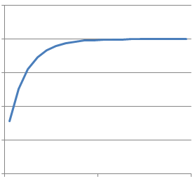
Further analysis
Method:
Case 1: L=0 (No left-turn bay)
All traffic evenly distribute between two through lanes:
V₁+V_{LT}=V_{TH}-V₁ -> V₁=V_{TH}/2-V_{LT}/2
Case 2: L-> $∞$ (Exclusive left-turn lane)
All through traffic evenly distribute:
V₁=V_{TH}/2
Normal case: With the increase of L, the V₁ increases
V_{TH}/2
Assumed relation:
V_{TH}/2-V_{LT}/2
$$V_{1}=\frac{V_{TH}}{2}−e^{−aL}∗\frac{V_{LT}}{2}$$
Length of left-turn bay

Slide 40
Further analysis
Use simulation results to obtain the parameter a.
Scenarios:
 | LT vph | TH vph | Bay length | # veh in Lane 1 | Parameter a
Case 1 | 400 | 800 | 4 | 203 | 0.00378
 | 400 | 800 | 6 | 233 | 0.03005
 | 400 | 800 | 8 | 279 | 0.06282
 | 400 | 800 | 10 | 296 | 0.06539
Case 2 | 200 | 800 | 4 | 297 | -0.00739
 | 200 | 800 | 6 | 340 | 0.08514
 | 200 | 800 | 8 | 355 | 0.09981
 | 200 | 800 | 10 | 368 | 0.11394
Case 3 | 400 | 400 | 4 | 77 | 0.12153
 | 400 | 400 | 6 | 89 | 0.09813
 | 400 | 400 | 8 | 118 | 0.11145
 | 400 | 400 | 10 | 129 | 0.10356
Case 4 | 200 | 400 | 4 | 131 | 0.09277
 | 200 | 400 | 6 | 151 | 0.11889
 | 200 | 400 | 8 | 159 | 0.11145
 | 200 | 400 | 10 | 161 | 0.09416
 |  |  |  | AVG | 0.08159
Model to estimate the V₁ :
$$V_{1}=\frac{V_{TH}}{2}−e^{−0.08L}∗\frac{V_{LT}}{2}$$

Slide 41
Further analysis
Problem 2:
Initial existing queue -> not known
Method:
Given any reasonable queue at first and after several iterations, see if the queue will become stable.

Slide 42
Further analysis
Result
left-turn traffic arrival rate (veh/hour): 400vph
through traffic arrival rate (veh/hour): 800vph
the saturation flow rate (veh/hour) : 2000vph
number of through lanes: 2
cycle length AD: 90s
through traffic green interval CD: 27s
left-turn traffic green interval BC: 27s
the length of left-turn lane : 6 veh
Note: if the input changes, the output shows the same pattern as above.
Conclusion:
Result shows that no matter the starting existing queue is, after several iteration, the left-turn queue and Point D becomes stable.
When the existing queue becomes stable, the resulting left-turn and through capacity should be regarded as the capacity for the target approach.

Slide 43
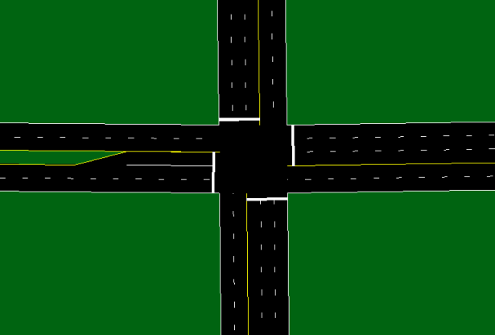
Model validation
Scenarios
Intersection geometry:
Target approach: Two through lanes, one left-turn bay.
Other approaches: Two through lanes, one left-turn lane.
Length of left-turn bay: 4veh, 6veh, 8veh, 10veh.
Traffic volume:
Target approach (W->E):
Through traffic: 500vph, 600vph, 700vph, 800vph.
Left-turn traffic: 200vph, 300vph.
Saturation flow rate: 2000vph
Opposite approach (E->W): The same with target approach.
Other approaches (N->S & S->N): Keep the same with each other and change with W-E approaches in order to keep the CLV(1800vph) and cycle length(90s) constant.
Reason: Input of the model is the arrival vehicles per cycle;
When one variables (through or left-turn volume) stay the same, the green time stay the same.
Signal plan:
Cycle length: 90s (If using webster’s equation: 75s)
Green splits: Using Synchro to obtain the optimal plans.
Simulation:
Using CORSIM to run for 3600 time steps.
Every scenario uses three different random seeds to observe the number of blockage and spillback situation in order to get the average probability.
600-VLT
1200-Vth

Slide 44
Scenarios
Scenarios | LT vph | TH vph | Bay length | # of TH lanes | CYCLE | TH GREEN | LT GREEN
Case 1 | 300 | 800 | 4 | 2 | 90 | 28 | 21
 | 300 | 800 | 6 | 2 | 90 | 28 | 21
 | 300 | 800 | 8 | 2 | 90 | 28 | 21
 | 300 | 800 | 10 | 2 | 90 | 28 | 21
Case 2 | 300 | 700 | 4 | 2 | 90 | 24 | 21
 | 300 | 700 | 6 | 2 | 90 | 24 | 21
 | 300 | 700 | 8 | 2 | 90 | 24 | 21
 | 300 | 700 | 10 | 2 | 90 | 24 | 21
Case 3 | 300 | 600 | 4 | 2 | 90 | 24 | 22
 | 300 | 600 | 6 | 2 | 90 | 24 | 22
 | 300 | 600 | 8 | 2 | 90 | 24 | 22
 | 300 | 600 | 10 | 2 | 90 | 24 | 22
Case 4 | 300 | 500 | 4 | 2 | 90 | 21 | 22
 | 300 | 500 | 6 | 2 | 90 | 21 | 22
 | 300 | 500 | 8 | 2 | 90 | 21 | 22
 | 300 | 500 | 10 | 2 | 90 | 21 | 22
Case 5 | 200 | 800 | 4 | 2 | 90 | 27 | 16
 | 200 | 800 | 6 | 2 | 90 | 27 | 16
 | 200 | 800 | 8 | 2 | 90 | 27 | 16
 | 200 | 800 | 10 | 2 | 90 | 27 | 16
Case 6 | 200 | 700 | 4 | 2 | 90 | 26 | 16
 | 200 | 700 | 6 | 2 | 90 | 26 | 16
 | 200 | 700 | 8 | 2 | 90 | 26 | 16
 | 200 | 700 | 10 | 2 | 90 | 26 | 16
Case 7 | 200 | 600 | 4 | 2 | 90 | 24 | 16
 | 200 | 600 | 6 | 2 | 90 | 24 | 16
 | 200 | 600 | 8 | 2 | 90 | 24 | 16
 | 200 | 600 | 10 | 2 | 90 | 24 | 16
Case 8 | 200 | 500 | 4 | 2 | 90 | 22 | 16
 | 200 | 500 | 6 | 2 | 90 | 22 | 16
 | 200 | 500 | 8 | 2 | 90 | 22 | 16
 | 200 | 500 | 10 | 2 | 90 | 22 | 16

Slide 45
Results
LT vph | TH vph | Bay length | # of TH lanes | CYCLE | TH GREEN | LT GREEN | Blocakge Prob |  |  | Spillback Prob
 |  |  |  |  |  |  | Simulation | Proposed Model | Current model | Simulation | Proposed Model | Current model
300 | 800 | 4 | 2 | 90 | 28 | 21 | 73.33% | 71.20% | 65.27% | 35.83% | 42.70% | 34.67%
300 | 800 | 6 | 2 | 90 | 28 | 21 | 48.33% | 42.40% | 67.69% | 6.67% | 5.97% | 30.69%
300 | 800 | 8 | 2 | 90 | 28 | 21 | 23.33% | 19.10% | 63.92% | 0.83% | 0.00% | 24.53%
300 | 800 | 10 | 2 | 90 | 28 | 21 | 0.00% | 6.53% | 49.36% | 0.00% | 0.00% | 15.09%
300 | 700 | 4 | 2 | 90 | 24 | 21 | 55.00% | 62.85% | 58.28% | 25.83% | 32.01% | 41.57%
300 | 700 | 6 | 2 | 90 | 24 | 21 | 35.83% | 32.83% | 58.51% | 1.67% | 3.20% | 38.31%
300 | 700 | 8 | 2 | 90 | 24 | 21 | 10.83% | 12.69% | 51.07% | 0.00% | 0.02% | 30.36%
300 | 700 | 10 | 2 | 90 | 24 | 21 | 0.00% | 3.78% | 34.14% | 0.00% | 0.00% | 17.70%
300 | 600 | 4 | 2 | 90 | 24 | 22 | 48.33% | 45.80% | 49.83% | 11.67% | 21.74% | 49.83%
300 | 600 | 6 | 2 | 90 | 24 | 22 | 30.83% | 18.06% | 47.09% | 0.83% | 0.19% | 47.09%
300 | 600 | 8 | 2 | 90 | 24 | 22 | 7.50% | 5.36% | 36.24% | 0.00% | 0.00% | 36.24%
300 | 600 | 10 | 2 | 90 | 24 | 22 | 0.00% | 0.12% | 19.86% | 0.00% | 0.00% | 19.86%
300 | 500 | 4 | 2 | 90 | 21 | 22 | 32.50% | 28.12% | 39.80% | 8.33% | 12.50% | 59.43%
300 | 500 | 6 | 2 | 90 | 21 | 22 | 14.17% | 8.42% | 33.78% | 0.00% | 0.07% | 56.41%
300 | 500 | 8 | 2 | 90 | 21 | 22 | 0.83% | 1.80% | 21.43% | 0.00% | 0.00% | 41.38%
300 | 500 | 10 | 2 | 90 | 21 | 22 | 0.00% | 0.00% | 8.98% | 0.00% | 0.00% | 21.32%
200 | 800 | 4 | 2 | 90 | 27 | 16 | 67.50% | 81.31% | 82.47% | 13.33% | 19.58% | 17.26%
200 | 800 | 6 | 2 | 90 | 27 | 16 | 54.17% | 52.90% | 84.55% | 0.83% | 1.41% | 11.32%
200 | 800 | 8 | 2 | 90 | 27 | 16 | 20.00% | 26.38% | 75.05% | 0.00% | 0.00% | 5.87%
200 | 800 | 10 | 2 | 90 | 27 | 16 | 1.67% | 9.81% | 53.66% | 0.00% | 0.00% | 2.01%
200 | 700 | 4 | 2 | 90 | 26 | 16 | 57.50% | 71.39% | 77.24% | 10.83% | 15.37% | 22.09%
200 | 700 | 6 | 2 | 90 | 26 | 16 | 39.17% | 40.17% | 76.69% | 1.67% | 0.72% | 15.20%
200 | 700 | 8 | 2 | 90 | 26 | 16 | 15.83% | 16.29% | 61.69% | 0.00% | 0.00% | 7.64%
200 | 700 | 10 | 2 | 90 | 26 | 16 | 0.00% | 4.90% | 37.52% | 0.00% | 0.00% | 2.42%
200 | 600 | 4 | 2 | 90 | 24 | 16 | 41.67% | 58.63% | 70.01% | 8.33% | 10.97% | 28.42%
200 | 600 | 6 | 2 | 90 | 24 | 16 | 26.67% | 27.09% | 65.10% | 3.33% | 0.36% | 20.03%
200 | 600 | 8 | 2 | 90 | 24 | 16 | 5.83% | 8.79% | 45.03% | 0.00% | 0.00% | 9.50%
200 | 600 | 10 | 2 | 90 | 24 | 16 | 0.00% | 2.11% | 22.06% | 0.00% | 0.00% | 2.77%
200 | 500 | 4 | 2 | 90 | 22 | 16 | 27.50% | 42.62% | 59.99% | 5.00% | 6.05% | 36.56%
200 | 500 | 6 | 2 | 90 | 22 | 16 | 12.50% | 14.72% | 49.43% | 3.33% | 0.16% | 25.54%
200 | 500 | 8 | 2 | 90 | 22 | 16 | 5.00% | 3.57% | 27.37% | 0.00% | 0.00% | 11.20%
200 | 500 | 10 | 2 | 90 | 22 | 16 | 0.00% | 0.53% | 10.07% | 0.00% | 0.00% | 3.01%

Slide 46
Results:
Case 1:
Bay length
Case 2:

Slide 47
Results:
Case 3:
Case 4:

Slide 48
Results:
Case 5:
Case 6:

Slide 49
Results:
Case 7:
Case 8:

Slide 50
Results
LT vph | TH vph | Bay length | # of TH lanes | CYCLE | TH GREEN | LT GREEN | Blocakge Prob | LT Capacity | Original LT Capacity | Spillback Prob | TH Capacity | Original TH Capacity
300 | 800 | 4 | 2 | 90 | 28 | 21 | 71.20% | 329 | 467 | 42.70% | 979 | 1244
300 | 800 | 6 | 2 | 90 | 28 | 21 | 42.40% | 380 | 467 | 5.97% | 1207 | 1244
300 | 800 | 8 | 2 | 90 | 28 | 21 | 19.10% | 428 | 467 | 0.00% | 1244 | 1244
300 | 800 | 10 | 2 | 90 | 28 | 21 | 6.53% | 454 | 467 | 0.00% | 1244 | 1244
300 | 700 | 4 | 2 | 90 | 24 | 21 | 62.85% | 341 | 467 | 32.01% | 896 | 1067
300 | 700 | 6 | 2 | 90 | 24 | 21 | 32.83% | 399 | 467 | 3.20% | 1050 | 1067
300 | 700 | 8 | 2 | 90 | 24 | 21 | 12.69% | 440 | 467 | 0.02% | 1067 | 1067
300 | 700 | 10 | 2 | 90 | 24 | 21 | 3.78% | 458 | 467 | 0.00% | 1067 | 1067
300 | 600 | 4 | 2 | 90 | 24 | 22 | 45.80% | 384 | 489 | 21.74% | 951 | 1067
300 | 600 | 6 | 2 | 90 | 24 | 22 | 18.06% | 446 | 489 | 0.19% | 1066 | 1067
300 | 600 | 8 | 2 | 90 | 24 | 22 | 5.36% | 476 | 489 | 0.00% | 1067 | 1067
300 | 600 | 10 | 2 | 90 | 24 | 22 | 0.12% | 486 | 489 | 0.00% | 1067 | 1067
300 | 500 | 4 | 2 | 90 | 21 | 22 | 28.12% | 421 | 489 | 12.50% | 875 | 933
300 | 500 | 6 | 2 | 90 | 21 | 22 | 8.42% | 469 | 489 | 0.07% | 933 | 933
300 | 500 | 8 | 2 | 90 | 21 | 22 | 1.80% | 484 | 489 | 0.00% | 933 | 933
300 | 500 | 10 | 2 | 90 | 21 | 22 | 0.00% | 489 | 489 | 0.00% | 933 | 933
200 | 800 | 4 | 2 | 90 | 27 | 16 | 81.31% | 219 | 356 | 19.58% | 1083 | 1200
200 | 800 | 6 | 2 | 90 | 27 | 16 | 52.90% | 261 | 356 | 1.41% | 1192 | 1200
200 | 800 | 8 | 2 | 90 | 27 | 16 | 26.38% | 308 | 356 | 0.00% | 1200 | 1200
200 | 800 | 10 | 2 | 90 | 27 | 16 | 9.81% | 337 | 356 | 0.00% | 1200 | 1200
200 | 700 | 4 | 2 | 90 | 26 | 16 | 71.39% | 229 | 356 | 15.37% | 1067 | 1156
200 | 700 | 6 | 2 | 90 | 26 | 16 | 40.17% | 283 | 356 | 0.72% | 1151 | 1156
200 | 700 | 8 | 2 | 90 | 26 | 16 | 16.29% | 326 | 356 | 0.00% | 1156 | 1156
200 | 700 | 10 | 2 | 90 | 26 | 16 | 4.90% | 346 | 356 | 0.00% | 1156 | 1156
200 | 600 | 4 | 2 | 90 | 24 | 16 | 58.63% | 250 | 356 | 10.97% | 1008 | 1067
200 | 600 | 6 | 2 | 90 | 24 | 16 | 27.09% | 305 | 356 | 0.36% | 1065 | 1067
200 | 600 | 8 | 2 | 90 | 24 | 16 | 8.79% | 339 | 356 | 0.00% | 1067 | 1067
200 | 600 | 10 | 2 | 90 | 24 | 16 | 2.11% | 351 | 356 | 0.00% | 1067 | 1067
200 | 500 | 4 | 2 | 90 | 22 | 16 | 42.62% | 276 | 356 | 6.05% | 948 | 978
200 | 500 | 6 | 2 | 90 | 22 | 16 | 14.72% | 328 | 356 | 0.16% | 977 | 978
200 | 500 | 8 | 2 | 90 | 22 | 16 | 3.57% | 348 | 356 | 0.00% | 978 | 978
200 | 500 | 10 | 2 | 90 | 22 | 16 | 0.53% | 354 | 356 | 0.00% | 978 | 978

Slide 51
Findings and conclusions
Findings:
For blockage situation:
a) the length of left-turn bay , the probability ;
b) the through traffic volume , the probability ;
c) the left-turn traffic volume , the probability .

Slide 52
Findings and conclusions
Findings:
For spillback situation:
a) the length of left-turn bay , the probability ;
b) the left-turn traffic volume , the probability ;
c) the though traffic volume , the probability .

Slide 53
Findings and conclusions

Slide 54
Findings and conclusions
Conclusions
The proposed model considers factors and natures that have not been included into the current models;
The proposed model shows better results compared with current models;
The proposed model needs more detailed input and assumptions.

Slide 55
Limitations and future work
Limitations
No field data for the validation;
No data for the capacity validation;
Arrival patterns are assumed to be Poisson distribution, however in reality, the coming vehicles may not follow this assumption;
The proposed method is not easy to apply, because it needs some iterations to get the stable condition;
The proposed method doesn’t consider the heavy traffic condition, which may cause the residual queue for through traffic after the green time;
The estimation of arrival rate for through traffic in adjacent through lane may need to consider more factors.

Slide 56
Limitations and future work
Future work
Try to collect some field data and try to find ways to obtain the probabilities of blockage and spillback;
Try to figure out how to validate the capacity results from the model.
Try to enhance the estimation model about the arrival rate for through traffic in adjacent through lane;
Try to consider the heavy traffic condition into the model;
Try to consider the mixed vehicles(buses, trucks) into the model.

Slide 57
Thank you!

